Slide 1

GSH Discharge Instructions
Hospital/Business Unit Name
Department Name

Slide 2
Important Guidelines
No heavy lifting, pushing or pulling (more than 10 pounds for 4-6 weeks)
You may use the stairs if you feel steady
No tampons or vaginal intercourse until cleared

Slide 3
Recovering at Home
Bowel function should return to normal 2-3 days after
Stay hydrated
Can eat your usual diet
You may drive once you are off opioids and pain-free

Slide 4
Wound (Incision) Care
No baths, hot tubs or swimming until wounds are healed
Showers are encouraged, washing incisions with antibacterial soap and clean wash cloth 2 times a day
Use separate wash cloth on incision, vaginal area, and rest of body

Slide 5
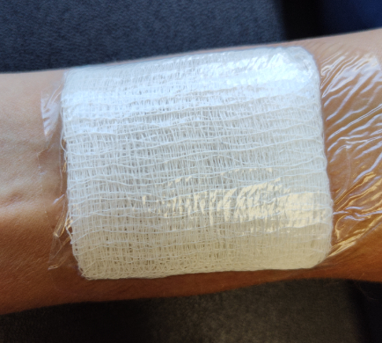
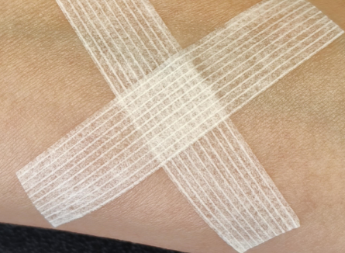
Wound Care
Gauze dressing should be removed
24 hours after
Steri strips should remain on for
7 – 10 days

Slide 6
When to call your surgeon
Infection around incisions
  Signs of infection: redness, swelling, warmth, foul odor
Increased pain
Pain with urination or blood in urine
Severe nausea and vomiting
Pain, swelling, warmth in your leg
Temperature greater than 100.5°F
Vaginal bleeding more than spotting
Any new symptoms
Shortness of breath or chest pain – Call 911

Slide 7
Megan Ronayne
Surgical Nurse Navigator
734-712-8438

