Slide 1
VOLUNTEER SERVICE ORIENTATION
We provide comfort, support, & security measures for our patients, families and visitors.

Slide 2
TABLE OF CONTENTS
Trinity-Health System Overview (TH)
TH-Service Excellence Standards
ICARE Communications/Patient Experience
Volunteer Policy, Procedures,& Expectations
Safety Protocols
HIPPA, Privacy & Confidentiality
Patient Rights & Responsibility
Volunteer Promise

Slide 3
Trinity-Health System
Trinity Health operates in 22 states, 93 hospitals, and employs nearly 131,000 people.
Trinity-Health is a health care organization serving six counties in southeast Michigan including Livingston, Macomb, Oakland, Washtenaw and Wayne. It includes 133-bed Trinity Health Chelsea, 537-bed Trinity Health Ann Arbor, 136-bed Trinity Health Livingston in Howell, 443-bed Trinity Health Oakland in Pontiac and 304-bed Trinity Health Livonia.
Combined, the five hospital are licensed for 1,726 beds, employs more than 14, 000 individuals and have a medical staff of nearly 2, 700 physicians.
For more information on health services offered at Trinity Health System, please visit www.trinityhealthmichigan.org
Hospital Incident Command Center

Slide 4
Trinity-Health Mission Statement
We, Trinity-Health, serve together in the spirit of the gospel as a compassionate and transforming healing presence within our community.

Slide 5


Volunteer Services Mission Statement
We add comfort, support, and security measures to the Trinity-Health patient experience.
Our goal in volunteering is to support the overall Trinity-Health mission of being a healing presence.
Volunteers a “Gift” to our Community

Slide 6
Trinity-Health Core Values
Core Values- Reverence, Commitment to Those Who Are Poor, Justice, Stewardship, and Integrity.
Living Our Values Actions:
Reverence: I connect with compassion and courtesy. I respect every person. I smile, acknowledge others, open doors, make eye contact, and say please and thank you.
Commitment to those who are poor: I reach out to help those in need. I escort patients & families to their locations. I notice when others are suffering or struggling and reach out to comfort and assist them.
Justice: I make every moment matter. I build and maintain healthy and trusting relationships. I avoid judging others because of differences or circumstances.
Stewardship: I engage everyday with an owner’s mind and a servant’s heart. I support other’s in fulfilling our mission.
Integrity: I practice gratitude, I put people at the center of all I do by being present and attentive.

Slide 7
Service Excellence: Attitude/Courtesy/Respect
In our healing environment, we treat all customers, colleagues, & volunteers with the respect and compassion regardless of age, sexual orientation, culture, religion, physical, social or economic status.
We strive to exceed expectations.
We listen first then respond.
We are always courteous and never rude.
We always assume the best and speak positively about the organization and team members in and out of the health system.

Slide 8
Service Excellence Standards
Commitment to each other.
Welcoming Environment & Teamwork
We value each other as individuals.
We are on time, prepared and begin and end meetings promptly.
We are empowered to own and solve problems.
We seek to learn and are open to new ideas & change.
We ask for, welcome and give feedback to each other in a timely, direct and constructive manner.
We act with honesty and integrity, taking responsibility for our actions.

Slide 9
Service Excellence Standards
Positive Impressions:
Environmental
We promote a quiet environment
We always clean our hands before and after contact with a patient , equipment, and their environment.
We create a safe workspace and “speak up: whenever we have a safety concern

Slide 10
Service Excellence Standards
Positive Impressions:
Environmental
We take ownership for keeping our environment clean.
We eat and drink in designated places.
We put equipment away and store it properly.

Slide 11
Service Excellence: A4 Approach
  The A4 approach is a model to handle customer complaints.
  Acknowledge the situation-
  I can see how this has been difficult Mr. Smith.
  Apologize for the situation-
  I am so sorry that you have not had a good experience.”
  Ask:
  How can we make this situation better for you?
  Act:
  This is what I will / can do. Are you comfortable with this?
  Then set follow-up expectations.

Slide 12
Service Excellence Standards
Service Recovery
We listen attentively when speaking with an upset customer.
We lower our voice, make eye contact and use extreme courtesy.
We offer personal help and take action even when rules are barriers.

Slide 13
Service Excellence Standards
Service Recovery
We always assume a solution can be reached.
We never make excuses or place blame when handling complaints.
We are empowered to address complaints and seek help when required.

Slide 14
Service Excellence: Communication Standards
ICARE
  Managing Up is a form of communication that positions information, a person, or team in a positive manner. Take the opportunity to speak positively of other providers, nursing, team members, volunteers, a department or the organization.
  Now let’s learn about ICARE a step-by-step format to speak to customers in a concise manner……

Slide 15
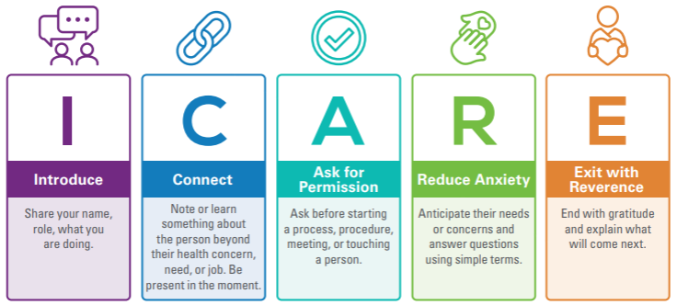
Because “I-CARE”, I Commit to…..
Notes:
Version:

Slide 16
ICARE
INTRODUCTION | …is an establishment of trust by using welcoming words, friendly gestures, creating familiarity, and showing a desire to help.
CONNECT | …is a focus on our shared humanity, curiosity, and compassion. Connection is providing a space where people can feel like they are a part of something big together, not “us vs. Them” - A partnership.
ASK FOR PERMISSION | …is a minute-by-minute inclusion practice that empowers and encourages those we are communicating with to be fully aware, involved, and present in the interaction.
REDUCE ANXIETY | …is a constant and conscious choice to interact with others in a way that reduces feelings of tension, worried thoughts – compassionately cheering up, or calming down, those around us. Building confidence.
EXIT WITH REVERENCE | …is re-creating a meaningful connection as the interaction draws to a close through sacred acts like respect, humility, empathy, and kindness.
Notes:
3-4 minutes
Introduction
Trinity Health’s Ministry Leadership Council, made up of our regional CEOs and Executive Leadership Team at the system level, have approved ICARE as Trinity Health’s service standards for these reasons:
Evidence based model; implemented internally and externally with proven results
Simple, easy to remember
Incorporates what matters most:
Basic courtesy, respect and empathy
Communication – clarity, listening
Partnering/engaging with patient
Establishes a long-term framework, providing foundation for full care experience program.
Creates and reinforces consistent expectations
Applies to all settings and all people (patients, clients, residents and colleagues)
Addresses Likelihood to Recommend key drivers and is aligned with Our Trinity Health Culture.
This is our WHY – WHY ICARE
Say:
ICARE is…a Relational Model with a patient experience approach that is recommended to more positively and effectively communicate with everyone we touch, patients and each other.
Each component of ICARE represents an opportunity for us to connect each action to each human to human interaction.
Review each component and WHY each one is important.

Slide 17
ICARE
I N T R O D U C E | Looks Like… | Sounds Like… | Try to Avoid
I N T R O D U C E | Making eye contact A Welcoming smile Friendly gestures Reading the Room Updating the whiteboard (if applicable) | An initial greeting Announcing/Re-announcing yourself Your name Your role Your purpose A tone of voice that conveys a desire to help | Slang words Asking for identifiers before greeting Over or Under-communicating Reactive or defensive tones or body language
Notes:
1-2 minutes
We have talked about the why. Now we will look at the behaviors and actions that demonstrate that “ICARE”.
The “i” stands for the action of “making an introduction”. As we stated previously introductions establish trust, provide valuable information and familiarizes the patient/person with what to expect.
Review slide contents
------------------------------------------------------------------------------------------
Optional Additional Information:
Knocking before entering the room
Re-introducing with each encounter, we do not assume they remember us and our role
Introduction: This is often the first impression. It is important that the patient knows who is helping them and how they are helping during their care. It is equally as important that we listen to their introductions - Along with a standard confirmation of demographics before charting we need to know who they are as well as who is with them or supporting them.
The Caritas processes associated with an “introduction” is comprised of name, role, and purpose, are loving kindness and co-creation through the establishment of an equal partnership and a healing environment whereall parties add value.
An introduction should always include the caregiver's name. This seemingly obvious detail is very important. It lessens the perceived power differential between caregiver and patient. This action facilitates equanimity by encouraging the release of ego-associations with roles and, instead, humanizing the initial interaction.
True co-creation of a healing environment cannot exist in a situation where one of the key players (the patient) is at a knowledge deficit related to their caregiver's role and purpose. When performing an introduction, after sharing their name, the caregiver shares their role and their purpose for being on the patient's care team.
Creating a healing environment at all levels; subtle environment for energetic, authentic caring presence
Equanimity with self/others
Creating a healing environment at all levels; subtle environment for energetic, authentic caring presence

Slide 18

Let’s Practice…INTRODUCE
Hey I’m Hugh. I work here. Let’s figure out what’s up.
Hi – I’m Hugh. I’m a computer technician here to update your computer.
Greetings my name is Hubert Malikowski and I am a computer technician in the Technical Information Services Department. I am here to update your computer with horrid Windows 10.
Notes:
3-5 minutes
Go through examples.
Ask: How do you introduce?
Ask: What does it feel like when we introduce?
Ask: What does it feel like when we do not introduce?
Based on group participation and time restraints, you can pick and choose what to elaborate on.
--------------------------------------------------------------------------------------------------------------------
Here’s a listening exercise to try with your team – ACTIVITY 2
Allow everyone to have a pen and paper handy, and then have someone read out this script:
"I’ll be asking you questions about what you’re about to hear. You can take notes if you like, but you don’t have to.
You’re a bus driver with a 40-seater bus and five stops. This is the route and the passenger details. Stop one, three people get on the bus. One person has a red hat; one person is elderly. Stop two, four people get on. One gets off the bus. Stop three, two people get on; one person is carrying a bag. The person with the red hat gets off. Stop four, two people get on the bus. One gets on with a pram. Stop five, three elderly people get on the bus. The person carrying the bag gets off the bus.
Now, how old is the bus driver?"
Before I reveal the crux – and without reading over any of the above again – what is your answer? Do you know how old the bus driver is? In my experience, some people will say 40. (There was a mention of 40 in there somewhere, wasn’t there?) Many will assume the bus driver is a man. Did the script actually say that? No. Nor did it give a specific age. The key is at the beginning. You’re a bus driver. Therefore the bus driver’s age is whatever your age is.
The reality is that most people are so heavily focused on the detail, that they miss this critical point in the introduction. The simple details are often the ones we miss when we’re not actively listening.

Slide 19
ICARE
C O N N E C T | Looks Like… | Sounds Like… | Try to Avoid
I N T R O D U C E | Noticing body language Empathizing Mirroring emotions Commit to sit Position yourself within 5-feet of the person At eye level with the person Facing toward the person | Inquiring about what you notice Making social comments Communicating that you want to help Sharing that you will be looking away at your computer occasionally | Judgement Blaming Dehumanization Over-communicating Downplaying situation Your hand on the door
Notes:
1-2 minutes
The “C” in iCARE stands for the action of “connecting”.
Review slide content
An iCARE connection does not use a formula or a script to direct the caregiver. Instead, caregivers are asked to be authentically present and intentional with their approach. Anything less is disingenuous.
As connections are made (initially, and with each successive interaction) a relationship begins to form. Information willingly shared between two people creates building blocks for future connections and conversations.
Taking the time to listen to the patient is part of connecting in iCARE.
-------------------------------------------------------------------
Optional Additional Information:
Connect: Research shows that it takes 56 seconds to connect with a patient. Oftentimes patients may be anxious when visiting the care facility. To help calm them connect on a reason other than their visit. Perhaps the weather, sporting events, or family milestones.
The Caritas processes associated with the action of “connecting” include inspiring, nurturing, and forgiving. This requires us to be authentically present and intentional. Through intention, attention, and consistency, a relationship is established and grows stronger with each successive encounter. We the time to authentically listen as a means of acknowledging and honoring each patient’s story.

Slide 20

Let’s Practice…CONNECT!
That’s gonna be a cool scar. Want to see mine?
I noticed you had quite a drive to be here today. How long have you lived in Ann Arbor?
Dude! I hate snakes! I can’t believe you bought that shirt!
Notes:
3-5 minutes
Go through examples.
Ask: How do you connect?
Ask: What does it feel like when we connect?
Ask: What does it feel like when we do not connect?
Based on group participation and time restraints, you can pick and choose what to elaborate on.

Slide 21
ICARE
A S K P E R M I S S I O N | Looks Like… | Sounds Like… | Try to Avoid
I N T R O D U C E | Treating the person with dignity Attention to privacy Being present in the moment Reading the room | Asking before: touching the person. starting a procedure - even something as simple as taking vitals. speaking using PHI in front of others in the room. Getting another team member involved in their care or resolution Knocking on the door to enter a room and waiting until you hear permission to enter. | Looking only at the computer. Making requests in a demanding way: “Take that off.” “Do they need to know?” Speaking loudly in public areas of with open doors Ignoring the emotions of others
Notes:
1-2 minutes
The “A” in iCARE stands for the action of “Asking permission” before embarking on a patient encounter.
Review slide content
-------------------------------------------------------------------
Optional Additional Information:
Asking permission before doing something to the patient is the third iCARE step. This is one of the most basic ways we can show respect to while providing opportunities to support the patient’s own agency.
The Caritas processes associated with the action of “asking permission” are ministering and trusting. It is but one powerful way of showing respect while preserving human dignity.
Sustaining human dignity
Being sensitive to self and others by cultivating own spiritual practices
Asking permission is a spiritual practice because it requires a pause to honor the dignity of the patient before proceeding with a task.

Slide 22
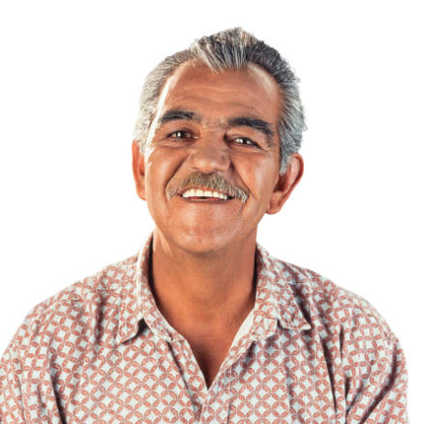
Let’s Practice…ASK PERMISSION!
We need to talk about your concerning results right now.
I’d like to discuss some of your test results. Would you prefer to review those results privately with me or include those in this room?
It looks like your bloodwork indicates….
Notes:
3-5 minutes
Go through examples. Note animations.
Based on group participation and time restraints, you can pick and choose what to elaborate on.

Slide 23
ICARE
R E D U C E A N X I E T Y | Looks Like | Sounds Like | Try to Avoid
I N T R O D U C E | Instilling Trust Warm hand-Off Managing Up Narrating care – explain the why for what you are doing - for safety, for….wristbands, name and date of birth, white board, etc. Active listening Teamwork | Reassuring they are in good hands Tell them about what they’ll love about you Introduce and celebrate upcoming supports and colleagues Explaining in simple terms Communicating delays Sharing the schedule for the day (care plan) | Unexplained acronyms Un-realistic timelines Belittling a person’s concern Over-explanations Spacing out Cracking jokes Closed-body language
Notes:
1-2 minutes
The “R” in iCARE stands for the action of “Reducing anxiety”.
Reduction of anxiety in the iCARE model is perhaps the most elevated step, requiring the most centering and emotional intelligence. In this step, loving-kindness and compassion is addressed through empathy and intuition to act.
The empathy exercises required to understand what type of anxieties a patient could be experiencing helps the caregiver shift into the patient's frame of reference.
This iCARE step necessitates the active use of empathic skills to understand the inner life-world of the patient and be able to anticipate needs. This not only reduces anxiety but supports faith and hope.
When a relationship moves to trust and care, it means the patient has confidence, hope, and belief in their caregiver's ability to own a level of responsibility in their own care. This method of relationship-developing and anxiety reduction can only be achieved by the patient feeling seen and understood within a relationship.

Slide 24

Let’s Practice…REDUCE ANXIETY!
Well it takes only a day or two for the radiologist to read your scan. But then the radiologist has to dictate their note. And then it needs to be in the system so I’m not sure when we’ll know for sure. Maybe a week. But if there is a problem probably sooner.
It will take about four days to get your test results back. If you have any questions before then, please give us a call.
No news is good news. If there is nothing wrong, you won’t hear from us.
Notes:
3-5 minutes
Reduce Anxiety: To help anticipate needs and concerns of patients we recommend narration of care. Narration of care provides the patient with exactly what is happening to them, who is doing it and why. For example: “Hi my name is______________, I will be your Medical Assistant today. To get you prepared for your visit with Dr. __________ I will start by taking your vitals, then we will review medications and history before the doctor comes in. Do you have any questions?”
Go through examples. Note animations.
Based on group participation and time restraints, you can pick and choose what to elaborate on.

Slide 25
ICARE
E X I T W I T H R E V E R E N C E | Looks Like | Sounds Like | Try to Avoid
I N T R O D U C E | Circle back to your relationship and reconnect with the person. Maintaining eye contact with all in the room to ensure all questions are answered. Scanning the environment: Lights Door Blankets Food/drink (if applicable) Not placing your hand on the door until the conversation is over and you are leaving. | Asking: What is one thing I can do for you before I leave? Asking: What is a question you still have? Encouraging the person to complete a survey for feedback Providing next steps Saying goodbye and wishing them well. | Being too straightforward Disrespectful tones Personal opinions Comparison “silver-lining” comments Leaving without saying anything.
Notes:
1-2 minutes
Finally, the “E” in iCARE stands for “Exiting with reverence”.
Exit with Reverence: Upon completion of the visit ask the patient “Is there anything else I can do for you? I have the time” That can feel difficult in the moment, but it improves care, outcomes, and relationships when we have met all the needs of the patient. It is more challenging to help a patient and resolve their issues once the patient has left our care sites.
The healing environment needs to be checked on and maintained throughout a patient's stay. This includes environmental assessments while taking into account the patient's preferences and ensuring that exiting the space is conducted in a calm and reverent manner.

Slide 26

Let’s Practice…EXIT WITH REVERENCE!
I’m done with what I came to do. I’m not sure when I’ll be back but I will be back eventually.
What else can I do for you?
…Okay. I’ll see you again in about an hour.
Bye
Notes:
3-5 minutes
Go through examples. Note animations.
Based on group participation and time restraints, you can pick and choose what to elaborate on.
reverence.

Slide 27
How ICARE Makes Your Day Easier and More Fulfilling
Efficiency - Less Stress, More Time: “I used to spend so much time fixing miscommunications. Now, with ICARE, I feel like I’m getting it right the first time.”
Empowerment - Confidence in Every Conversation: “I feel more in control, even in emotionally charged situations. ICARE helps me stay grounded and professional.”
Professionalism - Living Our Values: “Patients notice when we’re intentional. ICARE helps me show that I care, not just say it.”
Patient Experience - Making People Feel Seen: “I had a patient tell me, ‘You made me feel like a person, not a number.’ That’s the power of ICARE.”
Notes:
How ICARE Makes Your Day Easier and More Fulfilling
🕒 Efficiency: Less Stress, More Time
When you follow ICARE, you’re not just checking a box—you’re setting the tone for smoother interactions. By clearly introducing yourself and connecting with others, you avoid confusion and reduce the need to repeat or clarify later. That means fewer back-and-forths and more time to focus on what matters most.
“I used to spend so much time fixing miscommunications. Now, with ICARE, I feel like I’m getting it right the first time.”
💪 Empowerment: Confidence in Every Conversation
Whether you're navigating a tough patient interaction or collaborating with a colleague, ICARE gives you a reliable framework. You know what to say, how to say it, and when to listen. That kind of clarity builds confidence—and it shows.
“I feel more in control, even in emotionally charged situations. ICARE helps me stay grounded and professional.”
🎯 Professionalism: Living Our Values
ICARE isn’t just a tool—it’s a reflection of who we are. Every time you use it, you’re showing empathy, respect, and integrity. It’s a simple way to live out our mission and make a lasting impression.
“Patients notice when we’re intentional. ICARE helps me show that I care, not just say it.”
💬 Patient Experience: Making People Feel Seen
When patients feel heard and respected, everything changes. ICARE helps you create those moments—where someone feels truly cared for. And that’s what leads to better outcomes, higher satisfaction, and meaningful connections.
“I had a patient tell me, ‘You made me feel like a person, not a number.’ That’s the power of ICARE.”

Slide 28
Volunteer Procedures/ Check-In
You are required to swipe in and out everyday you volunteer. This is necessary for you to be covered by our liability insurance, to record your volunteer hours, and lastly consideration for service awards.
All volunteers should present in a happy and healthy manner prepared to serve in the role they are trained. Making a difference begins with you. Our patients, families , and visitors rely on your kindness and compassion to assist them through the health care journey.

Slide 29
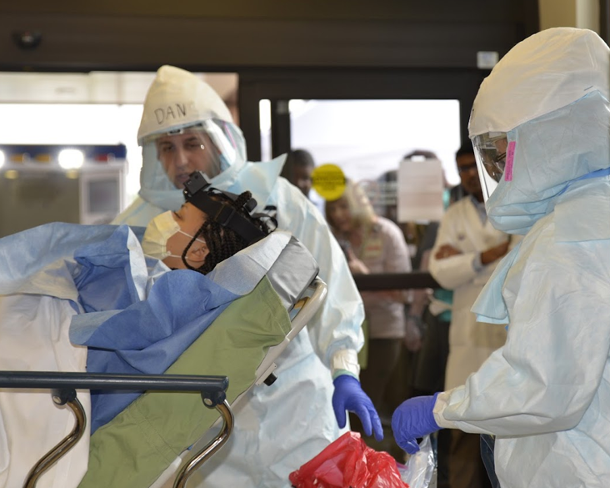
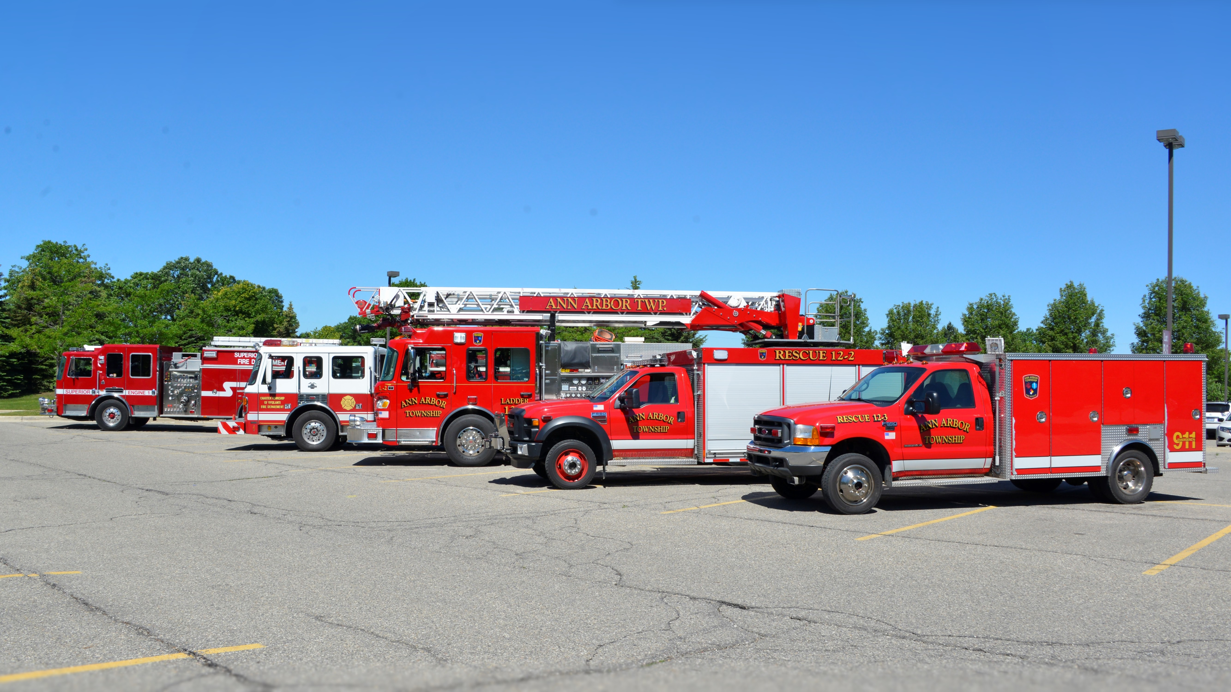
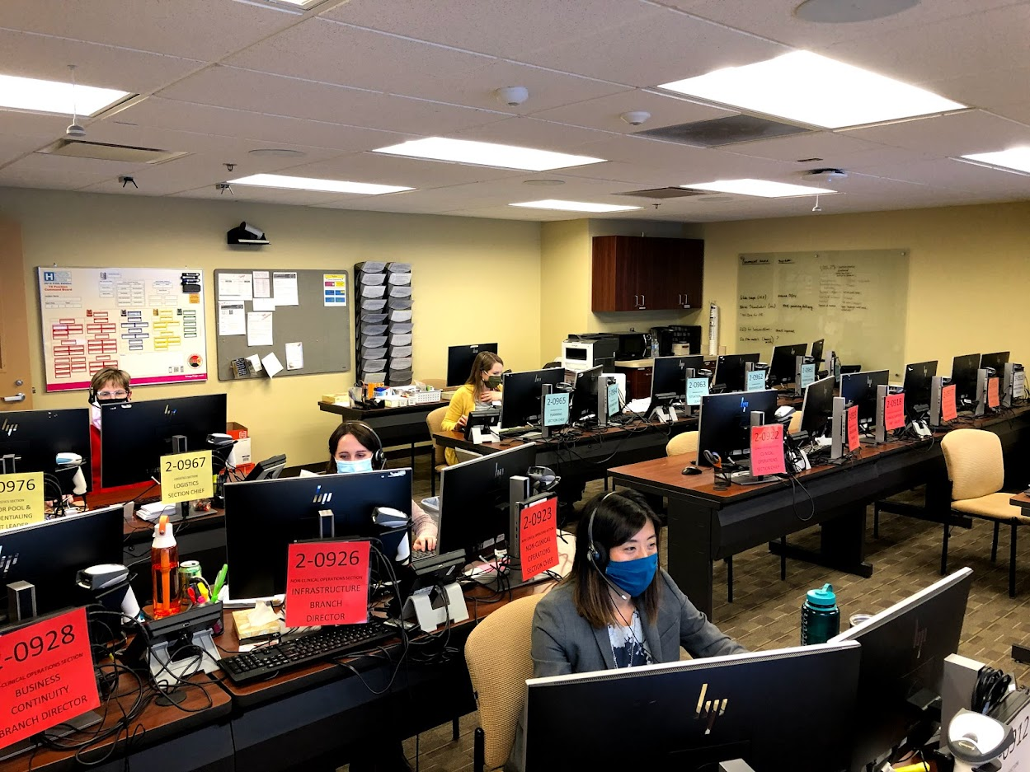
Volunteer Procedures Check in/Check out
Volunteer kiosks are located in the following locations at our hospitals.
Trinity Health Ann Arbor, Chelsea, & Livingston Front Desk/lobby area, Reichert Health Building info desk, Imaging Center hallway, & Ann Arbor emergency department discharge area. Canton & Brighton Health Centers main information desks upon entry.
Refer to your orientation packet on swiping in procedures for Vsys One.
Swipe in using the swiper if available.
Use the mouse to enter your volunteer ID number, located on the back of your badge if there is no swiper.
If the screen is changed, revert back to Zenworks to open up our program and/or hit the windows button.

Slide 30
Volunteer Procedures Dress Code Do’s & Don’ts
Do: Always do the following related to dress code and volunteer policy and expectations.
Wear your name badge and volunteer Trinity blue vest at all times when volunteering.
Don’t: Present for volunteering with any of the following.
No Jeans, capri pants, leggings, sweat pants, shorts, or jogging suits.
No sleeveless or midriff baring tops.
Wear closed toed shoes with hosiery
Final Thoughts…. Patients and families form opinions about our standard of care partially from the appearance of those caring for patients, therefore here are some final tips too.
You are responsible for the cleanliness and neatness of the Trinity volunteer vest.
Be conservative in hair, dress & make-up, with long hair tied back.
Use fragrance-free personal products.
No Sandals of any type, no bare legs
No excessive jewelry, No visible body piercings other than earrings.
No head covering except for religious or medical reasons.
No gum chewing.
The ID badge must be worn at the shoulder level and not be defaced in any way with stickers/pins attached.

Slide 31
Volunteer Procedures: Your Volunteer Liaison
Main contact person for the unit or dept. where you are assigned.
The person in charge of you and responsible for your specific orientation and training(although you may report weekly to other staff).
Please inform your liaison when you will be out of town, sick, or decide to discontinue volunteering.
Illness: If you are not feeling well, you should stay home and contact your liaison to let them know you will not be in on that day.
Attendance: Be punctual and regular in attendance but if you are unable to make a shift you should let your liaison know ahead of time. Meet commitment 4 hour &/or 6 -month annual serving requirement.
Accident on Duty: If you witness an accident or are injured yourself report to your department liaison immediately. An incident report will need to be completed.

Slide 32

Termination of your volunteer service:
Return your badge and uniform.
Inform your liaison in writing that you will not be volunteering anymore, including the last day.
Inform Volunteer Services in writing you will not be volunteering anymore.

Slide 33
Safety Protocols:
-infection control
-plain language
-fire alarm
-weather
-security/missing patient
-evacuation & shelter in place

Slide 34
Infection Control.
Hand washing is the single most effective way to prevent the spread of infection.
Hands must be washed:
On arrival to volunteer
Before leaving the restroom
Before and after eating
After removing gloves
Between handling of patients
After using the toilet, after blowing or wiping the nose
Before leaving the hospital

Slide 35
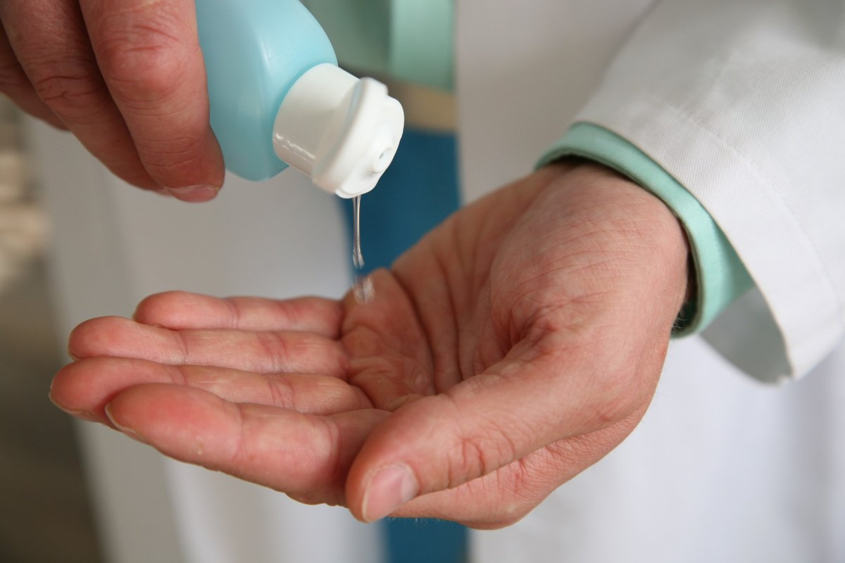
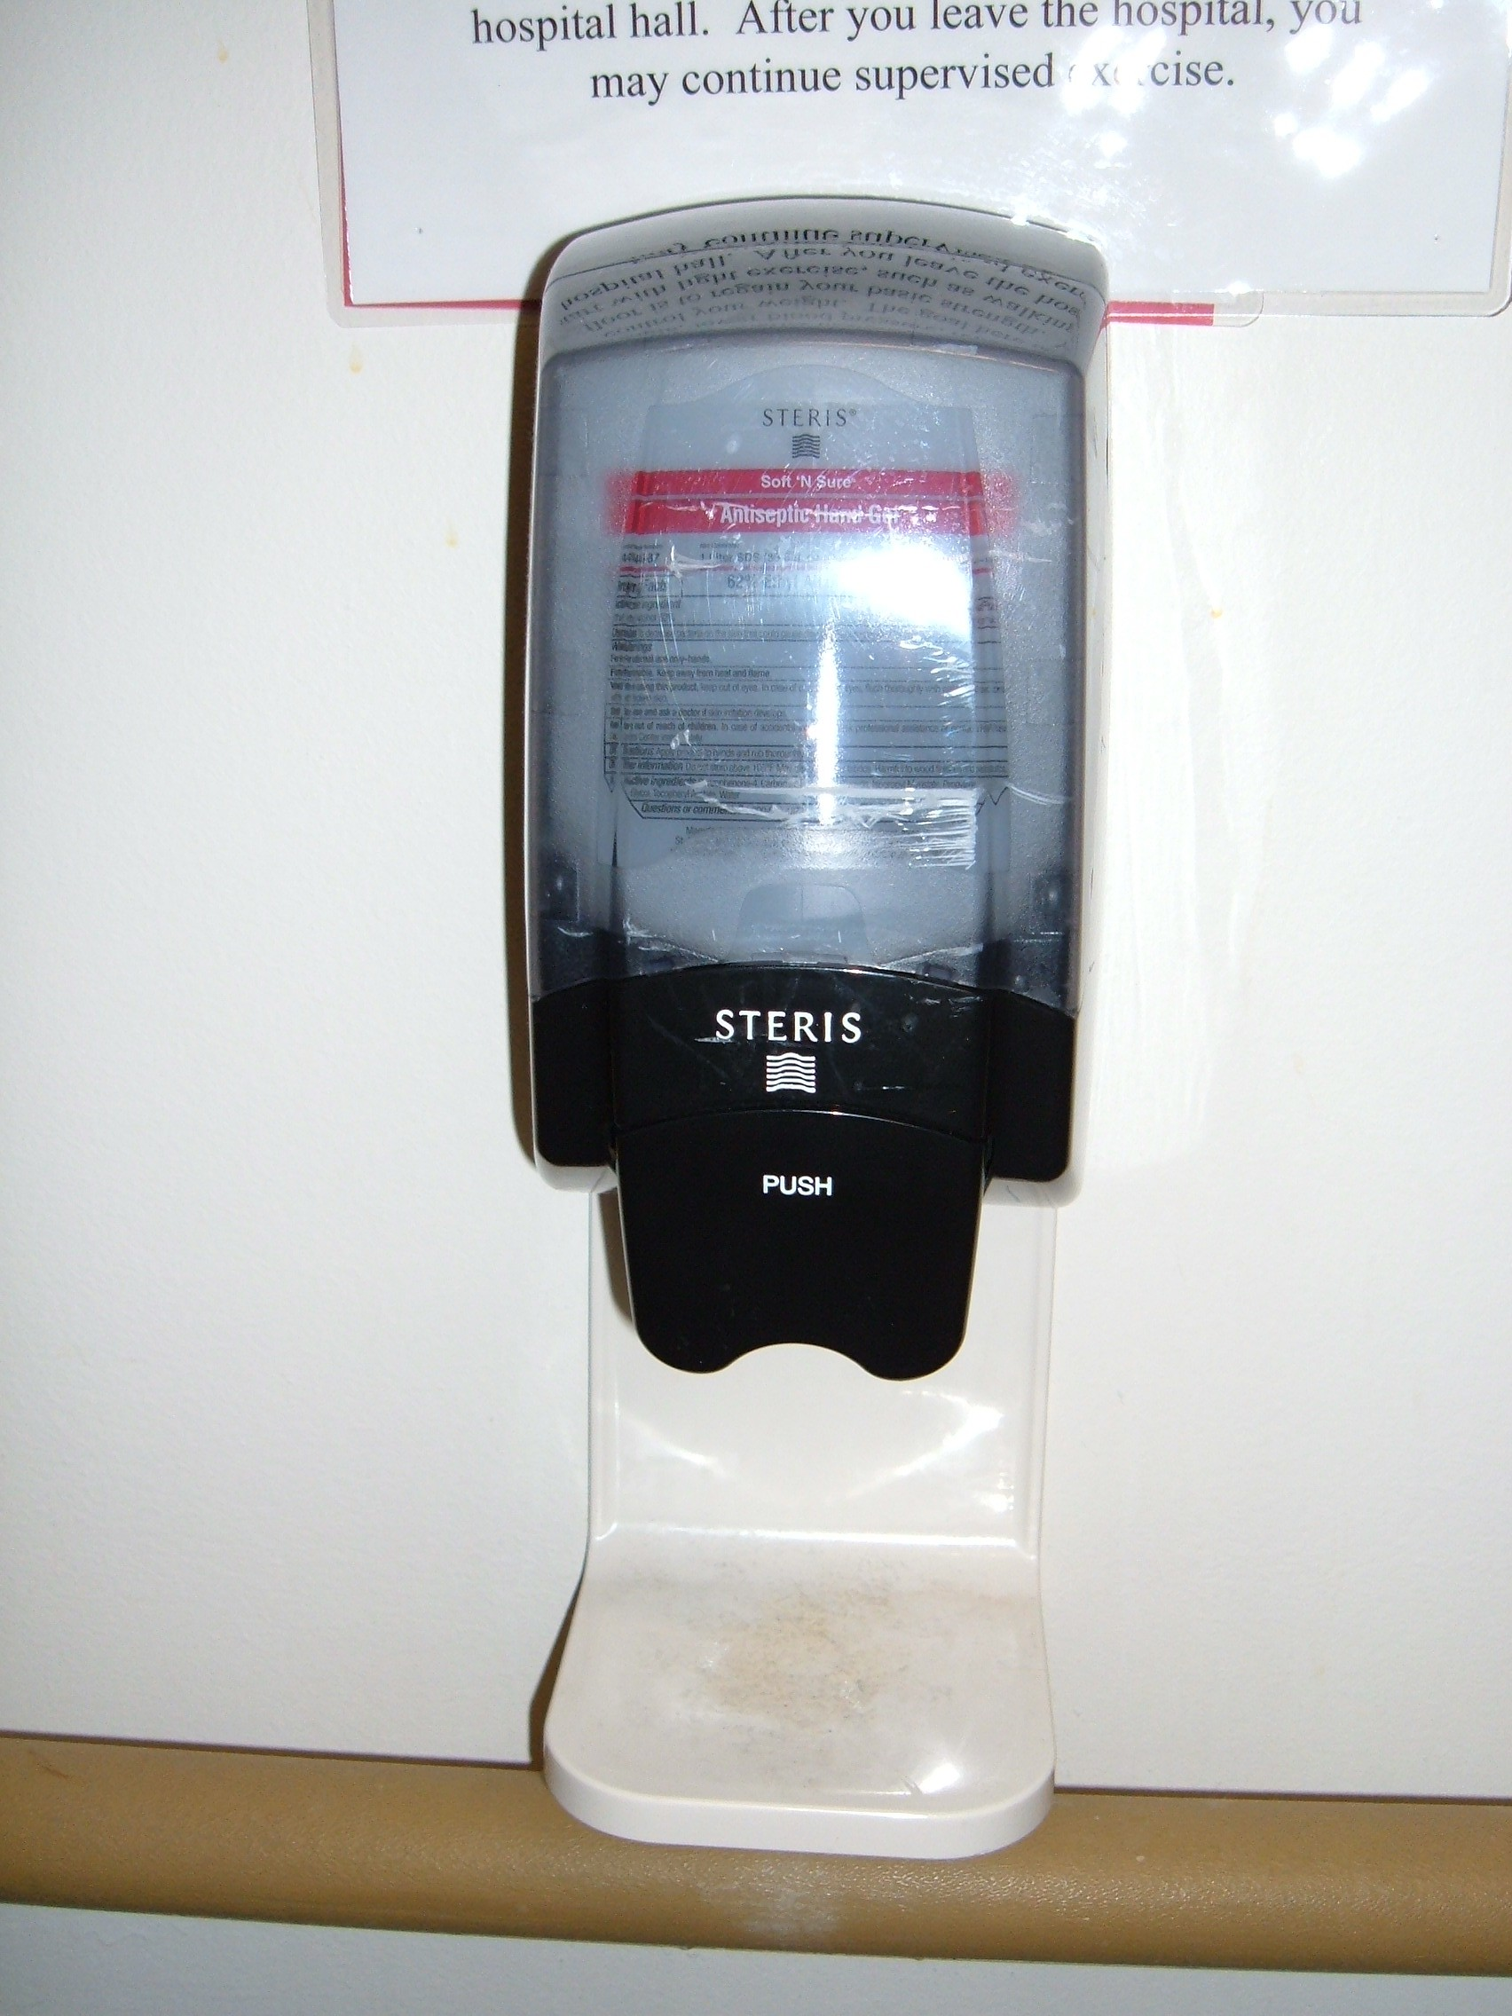
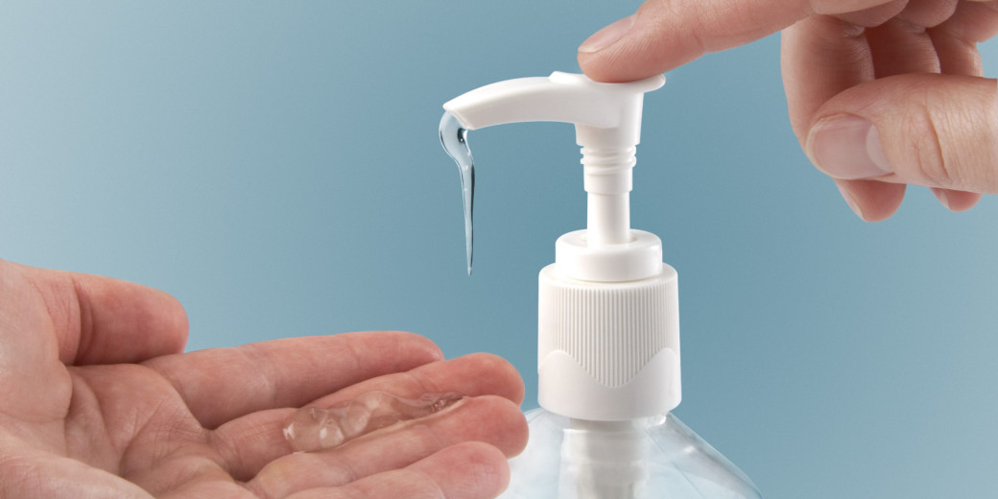
Please have visitors use hand sanitizers.
Make sure you keep some available at your station.

Slide 36
Plain Language
Hospitals use plain language for emergencies
The only color code is CODE BLUE
Event | Overhead Announcement "Your attention please..."
Disaster | "[Ministry] is responding to a(n) [specific] disaster. More information to follow."
Fire Alarm | "There is a fire alarm activation in[floor/unit/department]"
Code Blue | "There is a Code Blue in [floor/unit]"
Medical Emergency | "There is a medical emergency on [floor/unit/dept]"
Rapid Response | "There is a rapid response needed in [floor/unit]"
Severe Weather Event | "There is a [severe weather event] [watch/warning] in effect until [time]"
Missing infant or child and description | "There is a missing [child/infant]. [Description]"
Missing patient and description | "There is a missing patient. [Description]."
Security assistance required and location | "Security assistance is required in [location]"
Active Shooter and location | "There is an active shooter in [location]"

Slide 37
Code Blue
If you find someone UNCONSCIOUS / UNRESPONSIVE:
  Notify the Regional Call Center
      Utilize Code Blue button on phone, if applicable
Begin CPR if needed and if qualified
Obtain / Utilize AED if available
Remain until help arrives (team or ambulance)

Slide 38
Medical Emergency
If you find someone CONSCIOUS and RESPONSIVE (i.e., fall, hypoglycemia episode, seizure):
  Notify the Regional Call Center
  Remain until help arrives (dependent on location)
  If their status changes, update Regional Call Center

Slide 39
What to do in a Fire Alarm Activation
At Fire Scene, use R.A.C.E. to guide your actions:
  Rescue
  Alarm
  Close doors
  Extinguish / Evacuate
Also be sure to:
  Reassure patients
  Close doors
  Clear hallways

Slide 40
In a Fire Alarm Activation
DO NOT use elevators
MOVE EQUIPMENT on wheels in the hallways to one side (or to alcoves)
Make sure exits, extinguishers, and fire pull stations are not blocked
Remember: Never store items above 18’’ from the sprinkler head or below ceilings in rooms without sprinklers

Slide 41
Weather-Related Threats
When a weather-related threat occurs, you will hear:
"There is a [severe weather] [watch/warning] is in effect until [time]”
Patient Care Areas:
      Close the drapes/shades
      Check on and reassure patients
      Follow your departments severe weather plans
Non-Patient Care Areas:
      Close the drapes/shades
      Go to inner hallways away from windows
Listen For Updates

Slide 42
Security Assistance Required
You may need to act if you are concerned that a situation may escalate to a threat of harm or violence.
If you or others are in IMMEDIATE DANGER
      Move those in danger to safety
      Notify Regional Call Center that Security Assistance is needed (give location/description)

Slide 43
Missing Patient
If you are unable to find a patient, notify regional call center and ask the operator to initiate a “Missing Patient” and provide unit location and appropriate description.
  ALL Staff: Monitor all exit locations, stairwells and elevators for persons who look lost or confused and are attempting to exit the building wearing a patient gown, street clothes, or have on a patient identification armband or bandages.
  If staff suspect they have found the patient, ask the patient their name and if they can help return them to their room. Contact security and provide their location.
If the patient is at all hostile or aggressive, notify security and do not attempt to physically stop the individual.
  If the patient does leave, note helpful information: vehicle license plate, type of vehicle, direction of travel, description of person they are with, etc.
  Document the episode in the EMR and VOICE.
Behavioral Medicine Unit, Chemical Dependency Unit, and Birthing Center have locked doors and restricted access onto the unit.
  Do not open the unit doors for anyone, even if they have a badge. Unit staff will assist visitors and determine appropriate access to the unit.
  When exiting the unit, check for patients in the hallway. If there is a patient nearby, press the intercom button and ask staff to redirect patients away from the door area before you open the door.
  Check to make sure the door closes behind you. The door will make a click sound when lock-reactivates.

Slide 44
Other Threats
Notify regional call center and give specific details to the operator
Overhead announcements and instructions will be provided when appropriate
Disaster Response (Hospital Incident Command) will be activated as needed
Evacuate only if instructed to do so

Slide 45
Evacuation & Sheltering-in-place

Slide 46
Types of Evacuation
Horizontal Evacuation: This level of evacuation involves moving patients who are in immediate danger away from the threat. Patients remain on the same floor of the hospital as the area that they are evacuating. Horizontal evacuation typically involves moving patients to an area of refuge in an adjacent smoke/fire zone or in some cases, at the opposite side of the building. Most evacuations of a single department or patient care unit can be done horizontally, which is the fastest option and has the simplest re-entry process. Evacuation of an entire building may even be accomplished horizontally if every floor of the evacuated building connects to another building.
Vertical Evacuation: This level of evacuation refers to the complete evacuation of a specific floor in a building. In general, patients and staff evacuate vertically towards ground level whenever possible. Moving patients and staff to lower levels helps to prepare for total or full evacuation of the facility should the situation worsen. For most localized incidents, vertically evacuated patients and staff are sent to an area of refuge elsewhere in the hospital typically at least two floors away from the incident floor. During the vertical evacuation of one floor, other floors may be ordered to shelter-in-place or prepare only for their own evacuation.
Total or Full Evacuation: This level of evacuation is used only as a last resort and involves a complete evacuation of the facility. There are many different ways that a total or full evacuation can be planned for and managed.

Slide 47
Shelter-in-place
This level of evacuation requires ending all routine activities in preparation for an impending threat, such as a tornado or toxic cloud. Specific preparations should be made to mitigate against the anticipated threat.
In general, during a no-notice event, patients, visitors and staff remain where they are until they receive further instructions.
Closing doors/windows provides initial protection from fire, smoke, and other hazards.
During a shelter-in-place response, preparations should also be taken to enable immediate evacuation of patients should the situation change, and evacuation become necessary.

Slide 48
Staff Response and Notification
Depending on the threat, staff may need to stay in place or initiate evacuation out of the affected area.
  Hospital staff facing imminent danger from outside sources should stay in place.
  Hospital staff facing imminent danger from smoke, fire or infrastructure damage, should move out of the immediate area.
In both instances, staff need to report the emergency immediately. Inform area leadership of the event requiring sheltering in place or evacuation and activate the incident command alert (ICA).

Slide 49
Patient & Protected Health Information
In the event of an emergency/disaster or evacuation, the method for sharing and/or releasing location information and medical documentation for patients under the hospital’s care are consistent with requirements of law or regulation.
Policy links below address disclosure of protected health information to the following individuals or entities:
  Patient’s family, representative, or others involved in the care of the patient
  Disaster relief organizations and relevant authorities
  Other health care providers
ICP.3 Use and Disclosure of Protected Health Information
ICP.11 Individual Rights Regarding Restrictions and Confidential Communications
ICP.16 Verification of Individuals Requesting Access or Disclosure of PHI

Slide 50
Emergency Management Contacts
Denise Bechard, Manager, Emergency Management, Denise.Bechard@trinity-health.org
Jacquelyn Smith, Emergency Management Coordinator, Jacquelyn.Smith@trinity-health.org

Slide 51
Health Insurance Portability and Accountability Act (1996).
Patient Rights & Responsibility

Slide 52
HIPAA & PRIVACY
The Privacy Rule of the Health Insurance Portability and Accountability Act of 1996 (HIPAA) establishes national standards to protect individuals’ medical records and other personal health information.
The HIPAA Privacy Rule also gives individuals rights over their health information, like getting a copy of their records and seeking correction.
The Rule applies to 3 types of HIPAA covered entities, like health plans, health care clearinghouses, and health care providers that conduct certain health care transactions electronically to safeguard protected health information (PHI) entrusted to them.

Slide 53
Confidentiality and HIPAA
Treat all information patients share as confidential.
Do not ask about diagnosis or treatment plans.
Never read a patient’s medical chart.
All verbal discussions related to a patient's care should not be discussed in public areas.

Slide 54
Patient Rights & Responsibilities
Key Patient Rights
Respect and Dignity: To receive care without discrimination regarding age, race, religion, gender, or disability.
Information and Consent: To receive complete, clear information about diagnosis, treatment, and prognosis to make informed decisions.
Privacy and Confidentiality: To have medical records kept confidential and to experience privacy during examinations.
Participation in Care: To be involved in developing their treatment plan and to make decisions about their care.
Refusal of Treatment: To refuse treatment to the extent allowed by law and be informed of the consequences.
Access to Records: To review and obtain copies of their medical records.
Safety: To be free from unnecessary restraint, seclusion, or abuse.

Slide 55
Patient Rights & Responsibilities
Patient rights ensure respectful, confidential, and safe care, including the right to informed consent, privacy, and participation in treatment decisions. Responsibilities require patients to provide accurate health information, follow agreed-upon treatment plans, show respect to staff, and meet financial obligations

Slide 56
Final Thoughts……
Make sure you take the volunteer quiz.
Commit to 6 months of service. (unless a seasonal program).
Prepare to make a difference in a patient's life by volunteering.
Wear your volunteer uniform.
Swipe in and out each time you serve.
Use ICARE in all your interactions.

Slide 57
WELCOME TO TRINITY-HEALTH VOLUNTEER SERVICES.
Volunteers a “Gift” to our Community

Slide 58
Evacuation Equipment

Slide 59
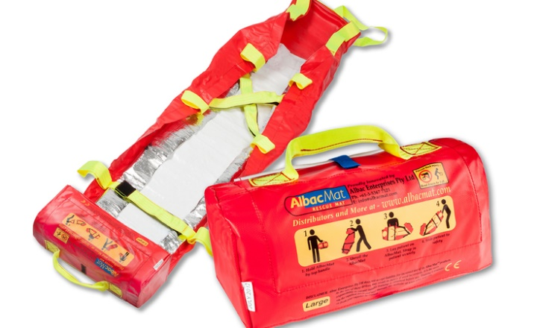
SJMHS: AlbacMat Rescue Mat Training Module
Evacuation Device for Non-Ambulatory Patients
Requiring Vertical Evacuation
At the conclusion of this module, you will be able to:
Verbalize when to use the AlbacMat vertical evacuation mat
Demonstrate how to employ the mat
How to clean the mat after use

Slide 60
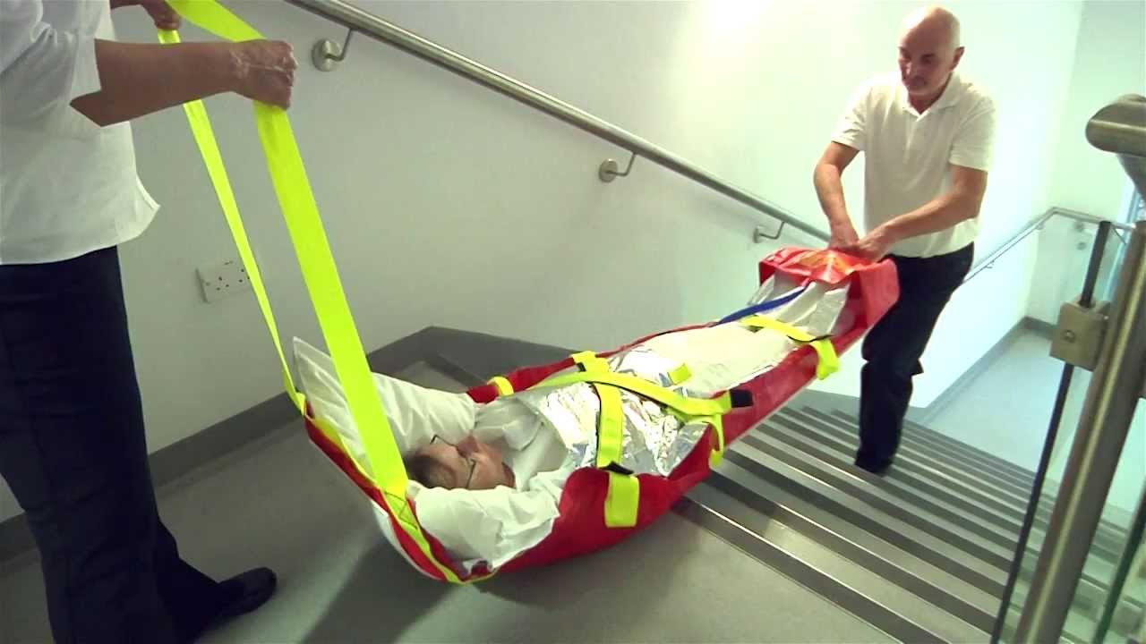
AlbacMat
In an emergency situation, unit leadership in collaboration with Incident Command when appropriate, will assess risk to patient safety and activate the appropriate level of evacuation for the situation when an immediate threat is apparent.
If a threat cannot be contained, horizontal evacuation is the first stage of evacuation. This may require movement of some patients beyond hallway fire doors within the unit or movement of patients to the ‘sister unit’ on the same level when available. If it is determined that a vertical evacuation is necessary, evacuation of non-ambulatory patients down stairways will be required.
The AlbacMat rescue mat is designed specifically for transporting the non-ambulatory patient during a vertical evacuation.

Slide 61
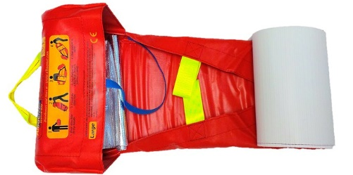
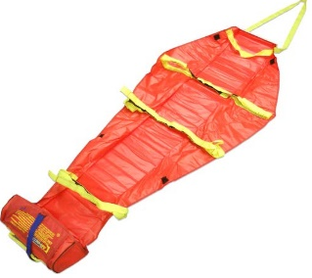
AlbacMat Features
Flexible stretcher that includes:
  Polypropylene flexible base board bottom that glides smoothly over most interior and exterior surfaces, provides insulation to protect the patient and helps absorb impact from rough terrain
  3 fluorescent yellow Velcro cross straps to secure the patient and provide detection in dim lighting
  Pulling handle at the head end and positioning handle at foot end
  Carry handles, 3 on each side for 6-8 person assist if required
  Foot rest pocket for comfort and security of patient within device
AlbacMat is self-contained in its own storage bag weighing (~4½ lbs.)
The bag portion of the mat becomes the foot pocket when in use
Mats accommodate 1000 lbs. Large mats should not be used
for bariatric patients due to their smaller size.
Simple instructions clearly visible on self-storage pocket

Slide 62
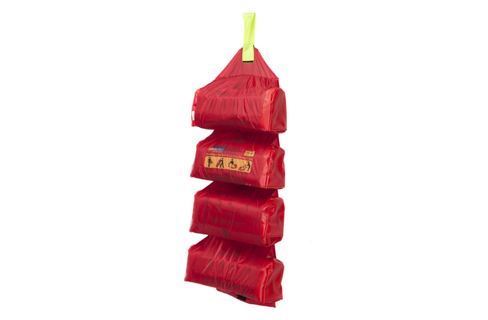
Storage Locations
For Ann Arbor, Mats will be stored on each patient floor, 2-11, in the Equipment Alcoves. No mats are required for 1E due to direct access to the outside.
Each Equipment Alcove will have a sign posted at the hallway entrance to indicate AlbacMats are stored within.
If space allows, AlbacMats will be stored in red soft hanging holders that neatly store 4 mats. If space is limited, mats will be placed on equipment shelves within the alcove.
For Livingston & Brighton, Mats will be stored on patient floors 2 and 3, in the equipment cabinets.
For Chelsea, Mats will be stored on Atrium East, Atrium West, the ICU, and Endo/Pain, in the equipment rooms.
In an emergency evacuation requiring vertical transport of patients, mats will need to go to where the patient needs are. Mats stored on one floor that are not needed by patients on that floor, should be shared with other floors upon request.

Slide 63

Care of the AlbacMat After Use
AlbacMats can be used more than once if there is no structural damage or excessive soiling that cannot be cleaned after use. After use, the AlbacMat should be wiped down with antibacterial wipes.
After Use Cleansing:
Obtain PPE: Gloves (Gown/mask/face shield as needed)
Disinfect all surfaces of the mat using antibacterial wipes:
Gray top for after use by non-isolation patients
Orange top with bleach for after use by isolation patients
Ensure cleaning agent remains wet on the surface for the appropriate contact time:
3 min for Gray top wipes 4 min for Orange top wipes
Dispose of gloves and wipes in the trash
Perform hand hygiene
Mats should dry completely prior to repackaging into their built-in bag and returned to their storage location.

Slide 64
Additional Post Use Facts
If there is excessive soiling of the mat during use, mats can initially be cleaned by hosing off the mat with water or thoroughly wiping mat clean with a damp cloth.
  Next, towel dry mat to remove the excess water
  Allow mat to completely air dry
  Use antibacterial wipes to do final cleansing of mat. Use of undiluted chemicals is not recommended.
Do not roll up and store the AlbacMat until it is completely dry.
Visually check the mat after each use or washing. Check the stitching, Velcro straps, base board (bottom) and pulling handles. If any damage has occurred the AlbacMat should be replaced.
If bodily fluids have leaked onto the webbing straps and cannot be removed, it is recommended that the AlbacMat be replaced to prevent cross-contamination during future use.

